Slide 1
Graphics Pipeline
- Kiran c Shettar

Slide 2

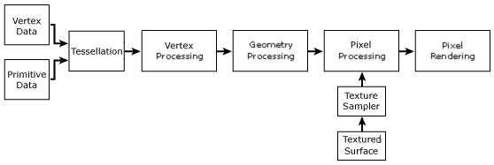
Over View
What is Graphics Pipeline?
Graphics Pipeline Structure

Slide 3
What is Graphics Pipeline?
Graphics system to render a 3D scene to a 2D screen
Create 3D model
Add features - Geometry
Translate from 3D to 2D – Projection
No Universal Graphics pipeline
Graphics APIs – Direct3D and OpenGL
Hardware Accelerated Rendering

Slide 4
Direct 3D vs OpenGL
Direct3d or D3D
OpenGL
Microsoft Windows Platform
x86, ARM
Release: 21years ago (1996)
Started by Microsoft
Version: 12.0 (Latest)
Varity of platforms
CAD, VR, Video Games etc.,.
Release: 25 years ago (1992)
Started by Silicon Graphics
Version: 4.6 (Latest)

Slide 5
Structure: Graphics Pipeline
Application
Geometry
Rasterization
Screen

Slide 6
Application
Executed by software on Main Processor (CPU)
Executed in pipeline manner
Parallel execution is possible: Multi-Core Processors
Changes are made to the scene as required
Animation, Collision Detection, Accelerating, Spatial Mapping

Slide 7
Geometry
Model & camera transformation
Lighting
Projection
Clipping
Window-viewport-transformation

Slide 8
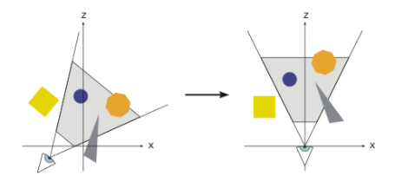
Model and Camera Transformation
Scene:
Virtual camera or viewer
Scene Rendering direction

Slide 9

Lighting
Scene contains a light source
Placed at different positions

Slide 10


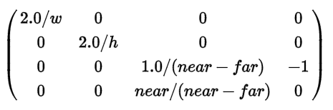


Projection
Rendering into Frame Buffer
Types
Central
Orthogonal (Parallel)
Z - buffer
MVP matrix for Orthogonal Projection

Slide 11
Clipping
Decide the view to be shown to the user
Primitives outside visual volume (frustum) are discarded
Prevent redundant object rendering

Slide 12
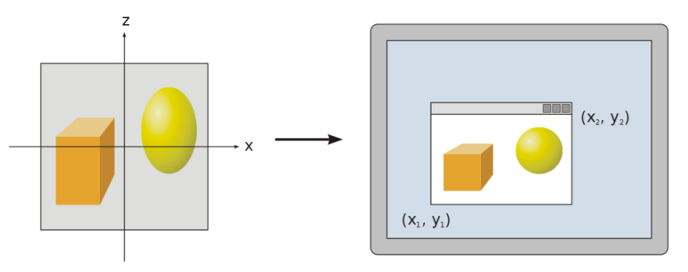
Window-Viewport-Transformation
Transform the object from frame buffer to view-port
Transformation Involves scaling the model
Contains 6 values
Height & Width of window in pixels
Upper left window co-ordinates (Ususally0, 0)
Minimum and maximum values for Z (usually 0 -1)

Slide 13
Rasterization
Converting Vertex Data into Pixels – Pixelising

Slide 14
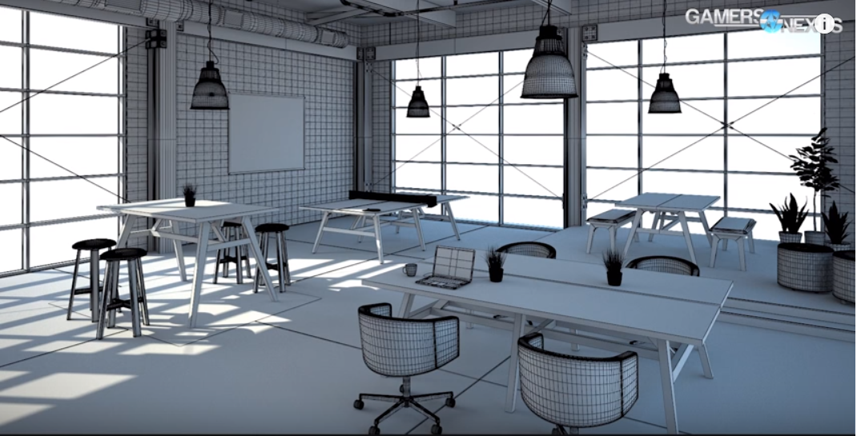

Slide 15
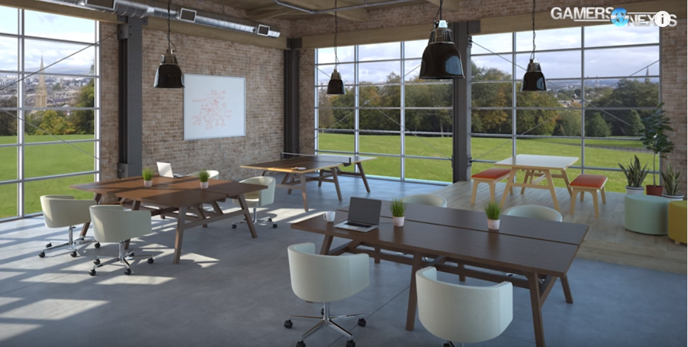

Slide 16


Slide 17
Thank You

